Slide 1
Unit 7 Summer

Slide 2
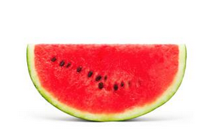
In Summer, I eat watermelons.

Slide 3
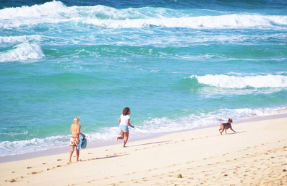
In Summer, I play on the beach.

Slide 4
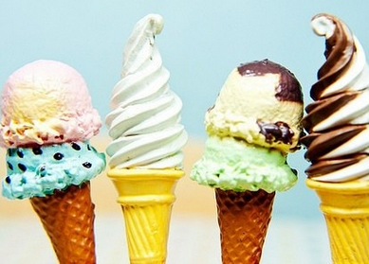
In Summer, I eat ice cream.

Slide 5
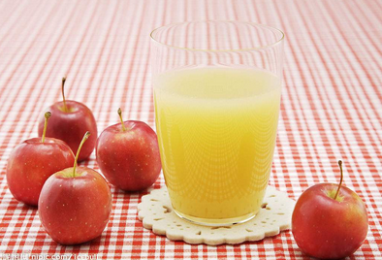
In Summer, I drink orange juice.

Slide 6


